Slide 1
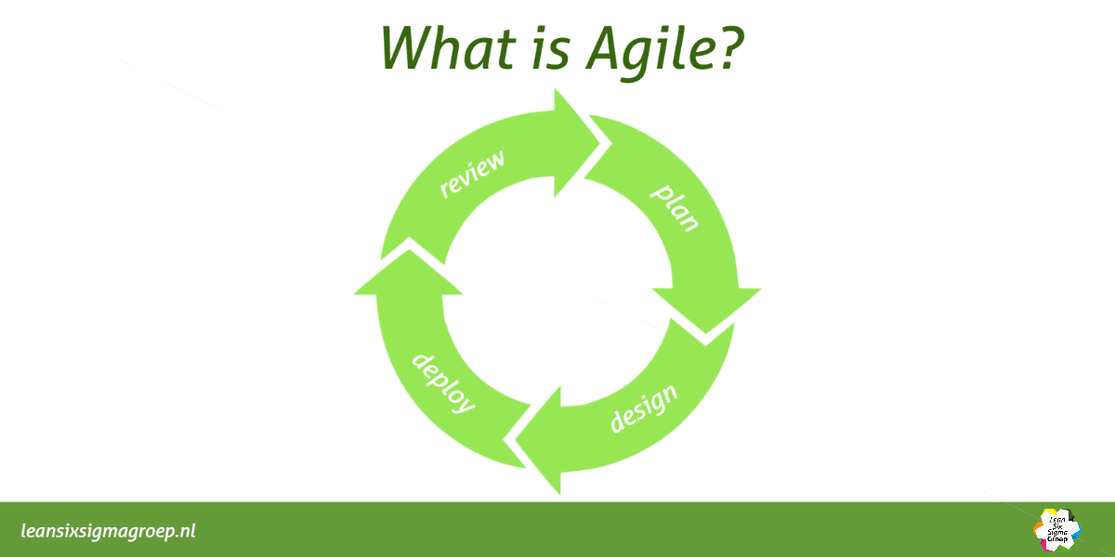
Introduction
What is Agile?
A set of principles that breaks large projects into small, manageable cycles.
Flexible, iterative approach to project management and product development.
Focuses on continuous improvement and
quick adjustments

Slide 2
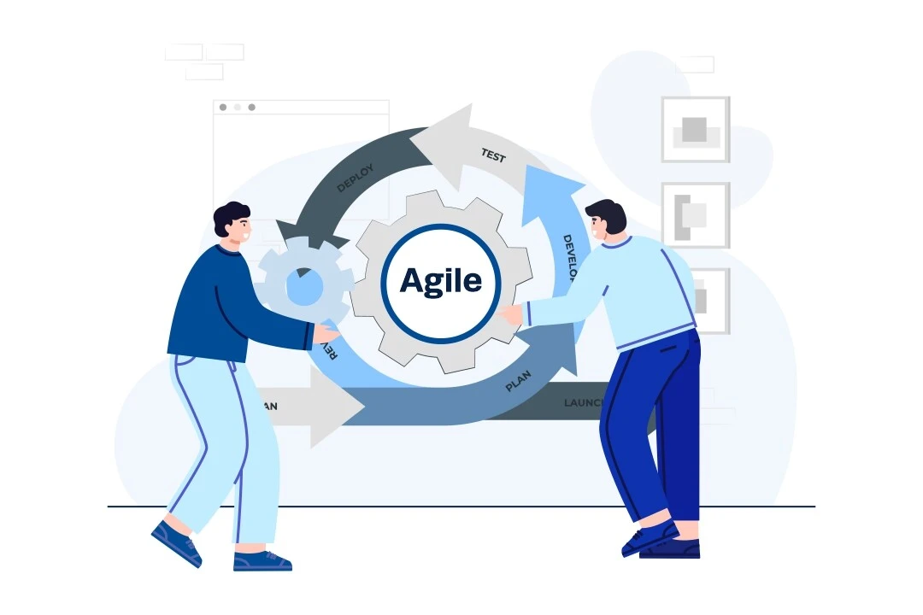
What is Agile Adaptation
It is the process of adjusting quickly and effectively to changes during a project.

Slide 3
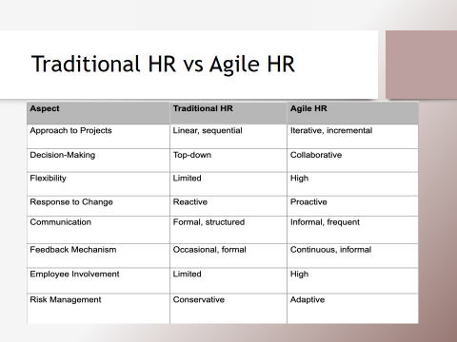

Slide 4
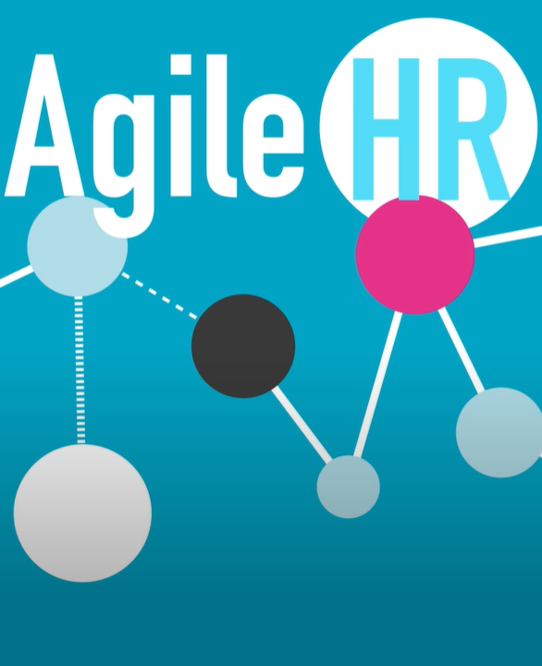
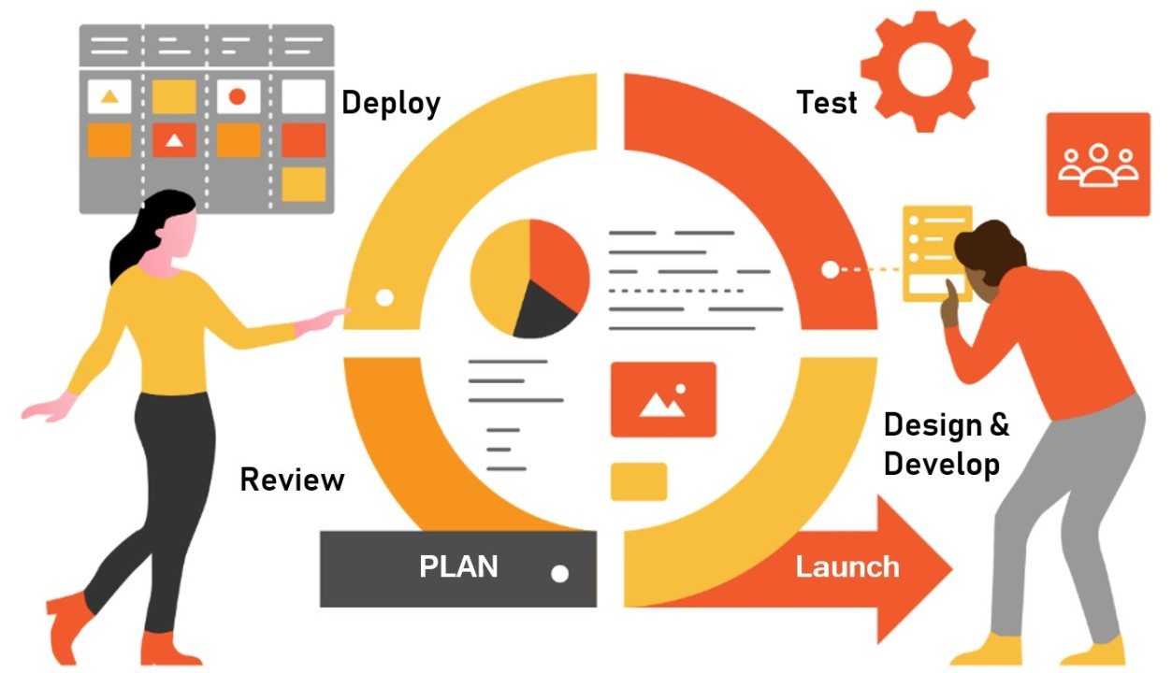
Agile Adaptation in Human Resource
It shifts HR from a traditional ,rules-based model to a more flexible and responsive one.
It helps respond faster to employee and business needs.

Slide 5
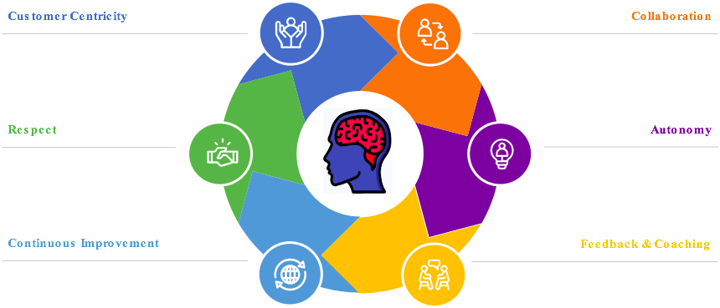
Agile Principles in HR
Enhance collaboration and teamwork.
Work is broken into small tasks for faster results.
Continuous improvement through regular feedback.
Employee needs and experiences stay at the center.

Slide 6
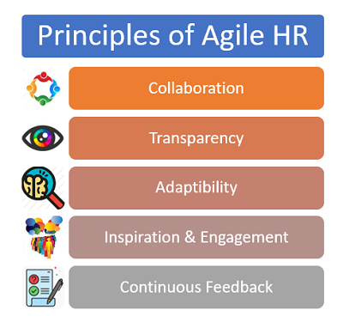

Slide 7
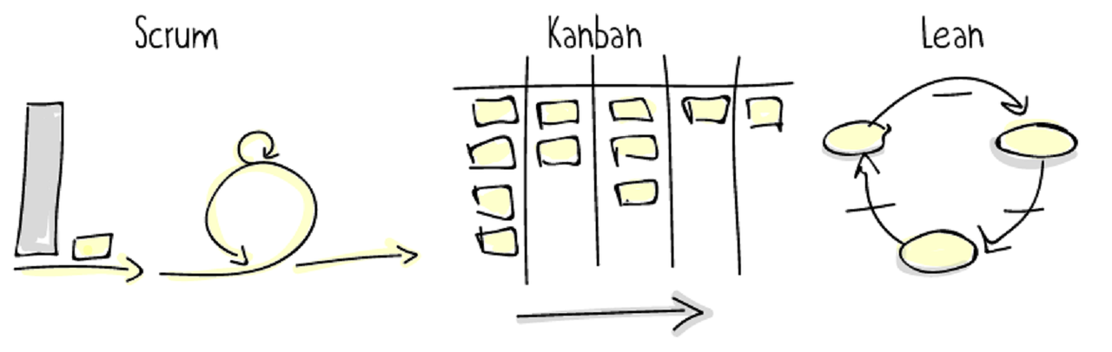
Agile Frameworks in HR
Short “sprints” to complete tasks quickly.
Daily brief meetings for alignment
Removes unnecessary steps from HR processes.
Focuses on efficiency and saving time
Visual boards (To-Do → Doing → Done).
Helps HR manage workload and track progress clearly

Slide 8
Agile Frameworks in HR
Scrum Scenario
Big loop → The whole recruitment cycle.
Small inner loop → Daily standups + quick problem-solving cycles that happen inside the big sprint.
HR is running a 2-week recruitment sprint.
The big loop = The 2-week hiring procesz.
Each day, HR team does a small loop (daily stand-up):
  “What did we do yesterday?”
  “What’s blocking us?”
  “How do we fix problems quickly today?”
Example:
A candidate cancels the interview.
➡️ HR immediately adjusts inside the small loop (re-schedule, move next candidate up, update hiring manager).
They don’t wait weeks — they fix the problem that is causing inner loop.

Slide 9
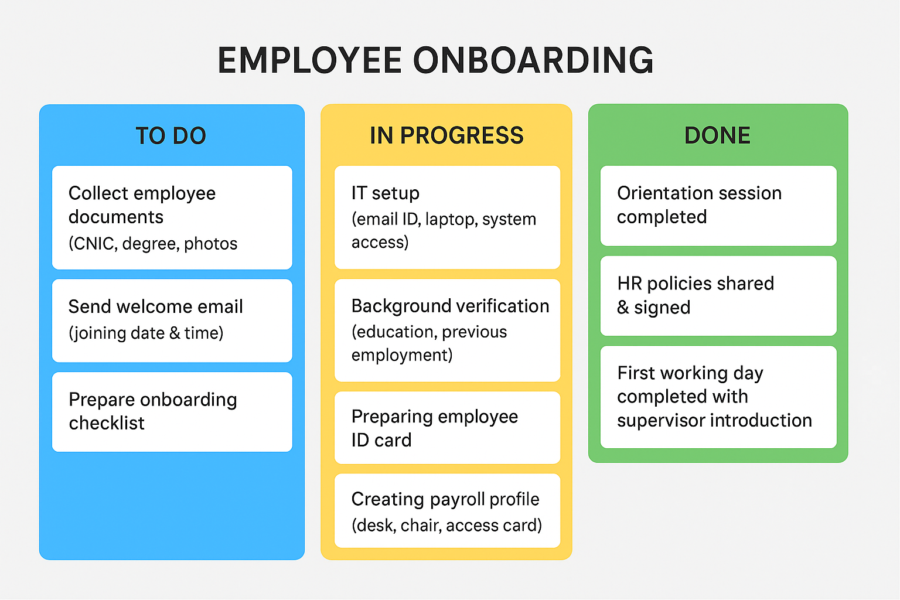
Agile Frameworks in HR
Kanban Scenario

Slide 10
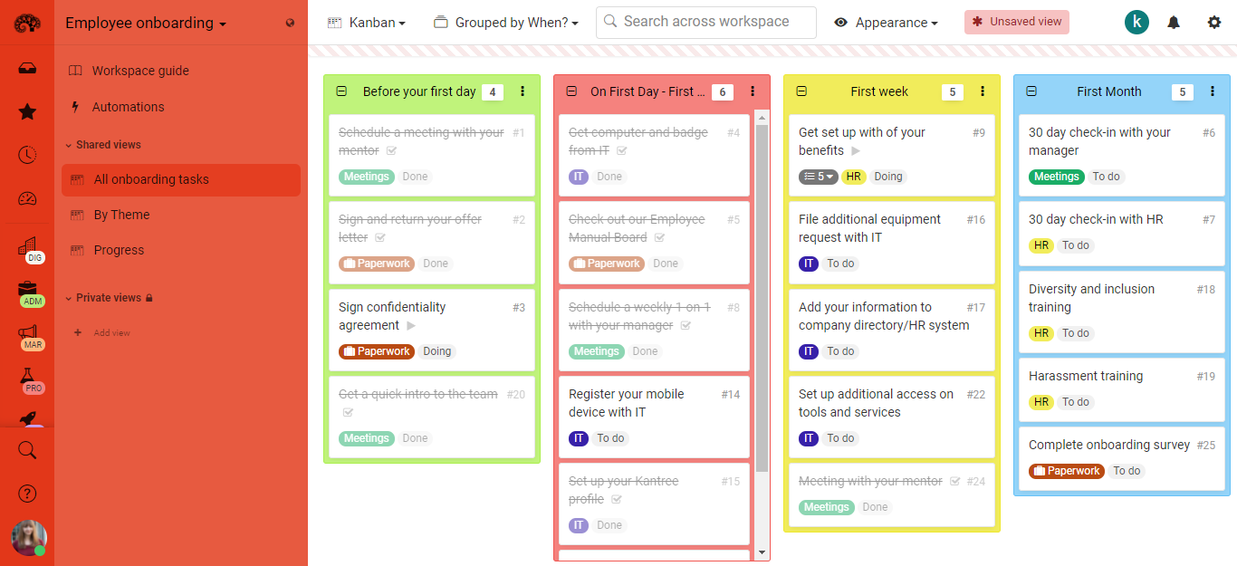
Agile Frameworks in HR
Kanban

Slide 11
Agile Frameworks in HR
Kanban ( Activity )
Create a Kanban board for a 15-day recruitment process.
At Day 1, everything is in To Do, and by Day 15 everything is Done, but you must show the board on Day 8, with some tasks still To Do, some In Progress, and some Done.
Make your board realistic and balanced for Day 8.

Slide 12
Agile Frameworks in HR
Lean Scenario
Problem (Before Lean):
Employee applied for leave through email.
Request moved Employee → Team Lead →
Manager → HR → Department Head.
Extra signatures caused delays and confusion.
Lean Action:
HR mapped the workflow and identified non-value-adding approvals.
Removed HR and Department Head from the chain.
Introduced a self-service HR.
Now the request goes directly to the immediate manager only.

Slide 13
Tradition VS Agile example
Traditional HR | Scrum
HR follows a step-by-step hiring plan and reviews progress only at the end. | HR breaks hiring into weekly sprints and reviews progress every day to adjust quickly.
Traditional HR | Kanban
HR manages tasks through emails and files, so it’s harder to see overall progress at one glance. | HR uses a visual board where all tasks move from To-Do → Doing → Done.
Traditional HR | Lean
Hiring a new employee needs 5 approvals from different departments. | Hiring is approved by only 1–2 key people to avoid extra steps.

Slide 14
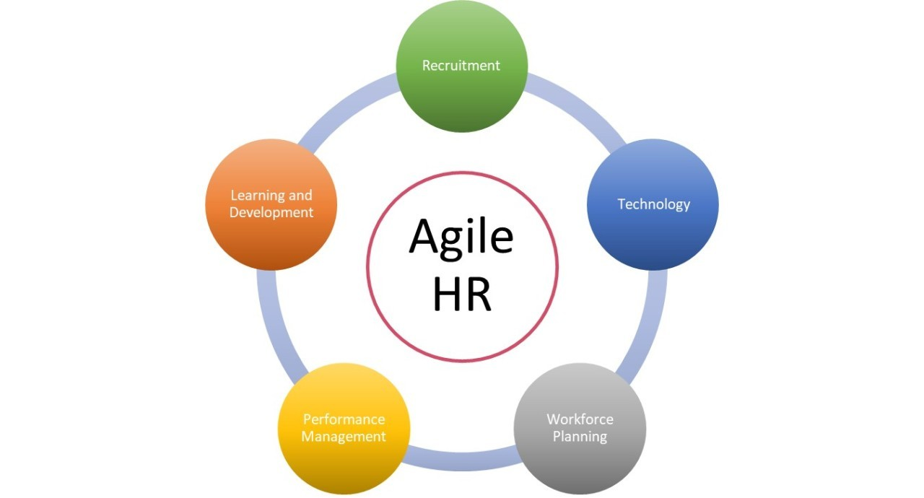
Where HR Applies Agile

Slide 15

Benefits of Agile HR
Faster decision-making and quicker problem solving.
Increased transparency because everyone sees task progress.
Better teamwork and communication within HR.
Higher employee engagement due to regular feedback.
HR processes become faster, smoother, and more effective

Slide 16
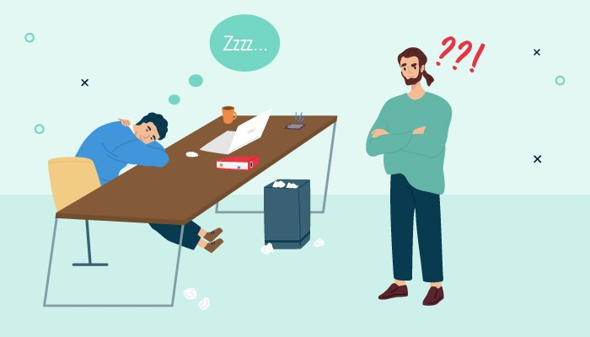
Challenges in Adopting Agile
Employees may resist the change due to old habits.
Lack of proper Agile training creates confusion.
HR may struggle to shift from traditional methods.
Misunderstandings like “Agile means no rules” slow down adoption.
Requires mindset change across the organization

Slide 17
Real-World Examples
Spotify: uses “squads” for quick decisions and innovation.
Google: continuous feedback culture replaces annual reviews.
ING Bank: small cross-functional HR teams for faster workflows.
These companies show how Agile improves speed and responsiveness

Slide 18
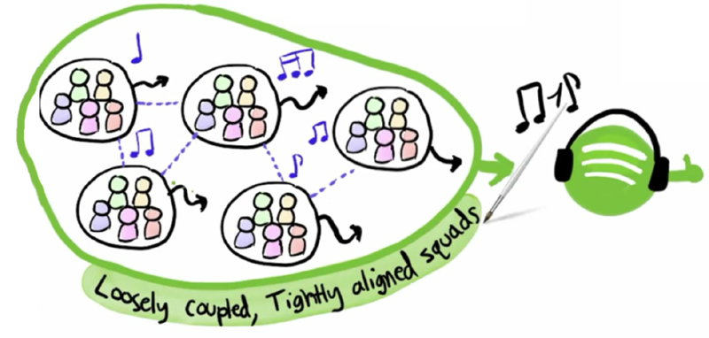
Real-World Examples
Spotify Squads
Spotify squads are small, independent teams that work like mini-startups inside the company. Each squad decides its own goals, tools, and solutions to improve one specific part of the product.
Ex: One squad only works on the “music recommendations” feature, while another squad focuses only on “playlist creation.”

Slide 19
VUCA Environment
VUCA (Volatility, Uncertainty, Complexity, Ambiguity) is closely connected to Agile Adaptation, especially in HR Management and Project Management.
If your project has high levels of VUCA parameters, it’s a good sign that you should consider an Agile approach.
An agile approach will lead to better outcomes.

Slide 20
Agile Response in VUCA Enironment
VUCA Element | What It Means | How Agile Responds
Volatility | Frequent and unpredictable changes | Agile uses short iterations, continuous feedback, and flexible planning
Uncertainty | Lack of clarity about the present or future | Agile emphasizes experiments, quick learning, and adaptability
Complexity | Many interconnected variables | Agile breaks work into smaller tasks and encourages cross-functional teams
Ambiguity | No clear cause-effect, unclear instructions | Agile promotes clarity through collaboration, stand-ups, and refinement

Slide 21
Example
VUCA Challenge | Healthcare Example | Agile Response
Volatility | Sudden patient load increase | Short planning cycles, rapid staffing changes
Uncertainty | New medical guidelines | Training sprints, continuous updates
Complexity | Many interdependent departments | Cross-functional teams, visual workflows
Ambiguity | Unclear cause of low patient satisfaction | Pilot testing, feedback loops

Slide 22
Conclusion
Agile HR = flexibility, speed, teamwork, continuous improvement.
Helps HR respond better to employees and organizational needs.
Makes HR processes faster, clearer, and more efficient.
Agile is essential for modern, competitive organizations

Slide 23
THANK YOU

